Slide 1
Coordination chemistry
DEPT OF LIFE SCIENCE
KUPPAM DEGREE COLLEGE

Slide 2
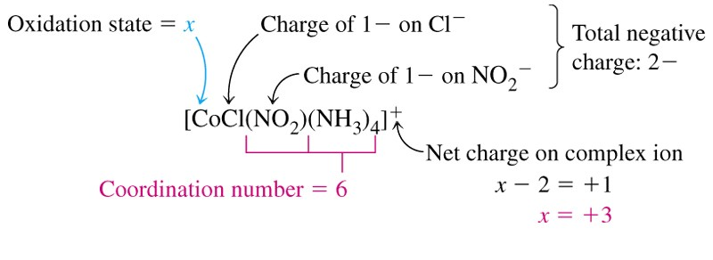
A coordination compound, sometimes called a coordination complex, contains a central metal atom or ion surrounded by a number of oppositely charged ions or neutral molecules (possessing lone pairs of electrons) which are known as ligands.
If a ligand is capable of forming more than one bond with the central metal atom or ion, then ring structures are produced which are known as metal chelates, the ring forming groups are described as chelating agents or polydentate ligands.
The coordination number of the central metal atom or ion is the total number of sites occupied by ligands. Note: a bidentate ligand uses two sites, a tridentate three sites etc.
CHEM210/Chapter 3/2014/01

Slide 3
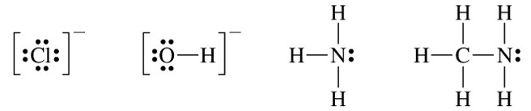
Molecular formula | Lewis base/ligand | Lewis acid | Donor atom | Coordination number
[Zn(CN)₄]²⁻ | CN⁻ | Zn²⁺ | C | 4
[PtCl₆]²⁻ | Cl⁻ | Pt⁴⁺ | Cl | 6
[Ni(NH₃)₆]²⁺ | NH₃ | Ni²⁺ | N | 6
TYPES OF LIGANDS
MONODENTATE
When ligands donate one pair of electrons to the metal atom.
chloro hydroxo
amine methylamine
CHEM210/Chapter 3/2014/02

Slide 4
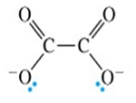

BIDENTATE
Ligands that contain two of more atoms, each of which can simultaneously form two-electron donor bonds to the same metal ion.
These ligands are also called chelate ligands.
ethylenediamine (en) oxalato (ox²⁻)
MULTIDENTATE
Diethylenetetramine (trien), EDTA, etc.
CHEM210/Chapter 3/2014/03

Slide 5
ISOMERS
Ionization isomers
Isomers can produce different ions in solution e.g.
[PtCl₂(NH₃)₄]Br₂ ⇌ [PtBr₂(NH₃)₄]Cl₂
Polymerization isomers
Loose term, “same stoichiometry, different arrangement in space”
Seven compounds with formula Co(NH₃)₃(NO₂)₃
Coordination isomers
[Co(NH₃)₆]³⁺
[Cr(NH₃)₆]⁻³
[Co(CN)₆]³⁺
[Cr(CN)₆]⁻³
Linkage isomers
e.g. Nitro and nitrito, N or O coordination possible.
CHEM210/Chapter 3/2014/04

Slide 6
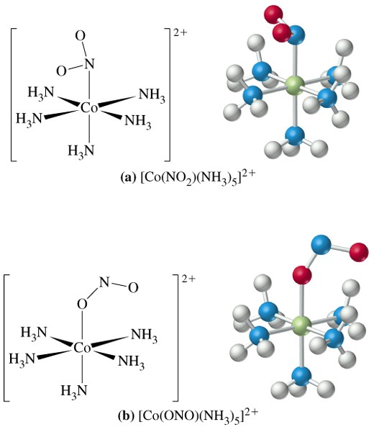
CHEM210/Chapter 3/2014/05

Slide 7
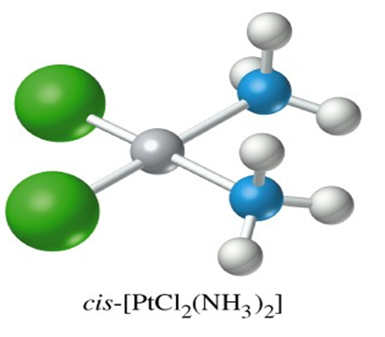
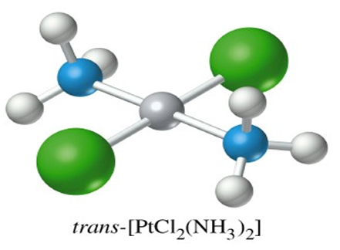
Geometric isomers
Formula is the same but the arrangement in 3-D space is different e.g. square planar molecules give cis- and trans- isomers.
For hexacoordinate systems other species, can also occur.
CHEM210/Chapter 3/2014/06

Slide 8
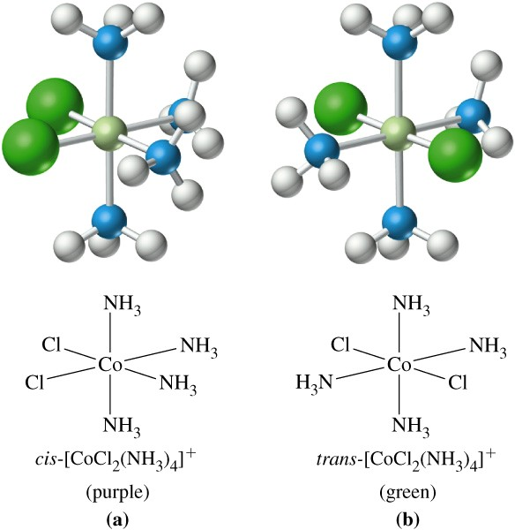
CHEM210/Chapter 3/2014/07

Slide 9
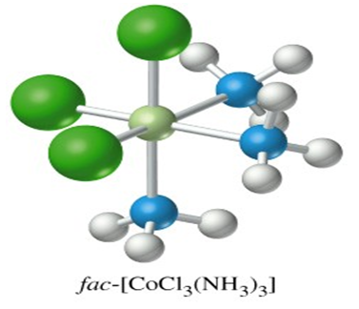
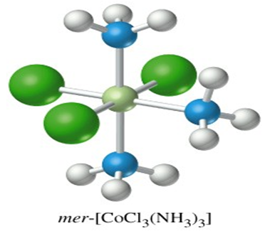
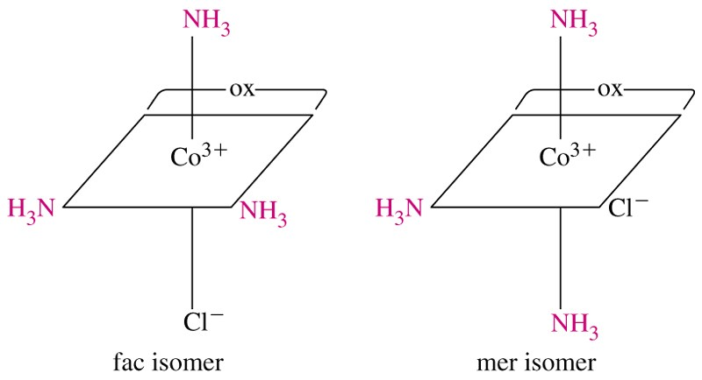
For M(X)₃(Y)₃ systems there is facial and meridian isomers.
CHEM210/Chapter 3/2014/08

Slide 10
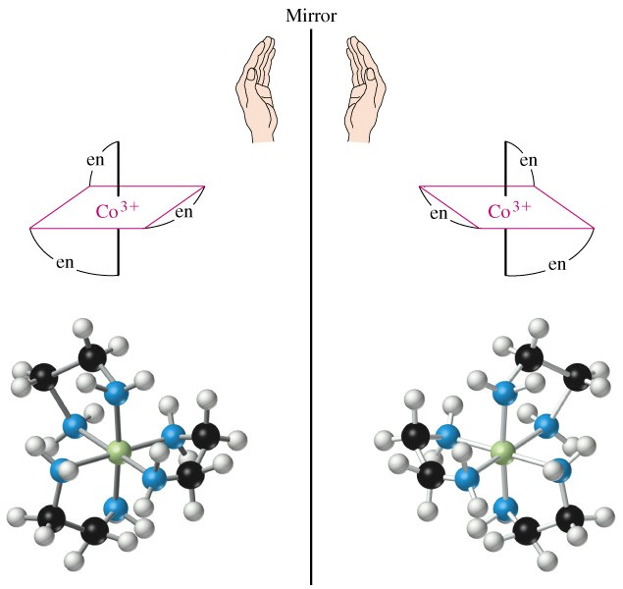
Are “stereo” isomers also possible? An analogy to organic chirality, molecules which can rotate light.
Enantiomers
Non-superimposable mirror images.
CHEM210/Chapter 3/2014/09

Slide 11
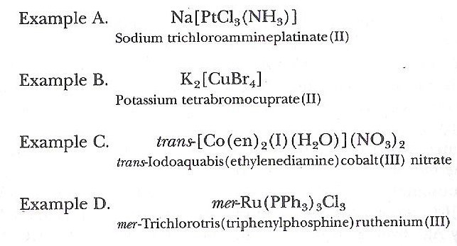
NOMENCLATURE FOR COORDINATION COMPOUNDS
Cotton, Wilkinson and Gaus, p 178- 183
CHEM210/Chapter 3/2014/10

Slide 12
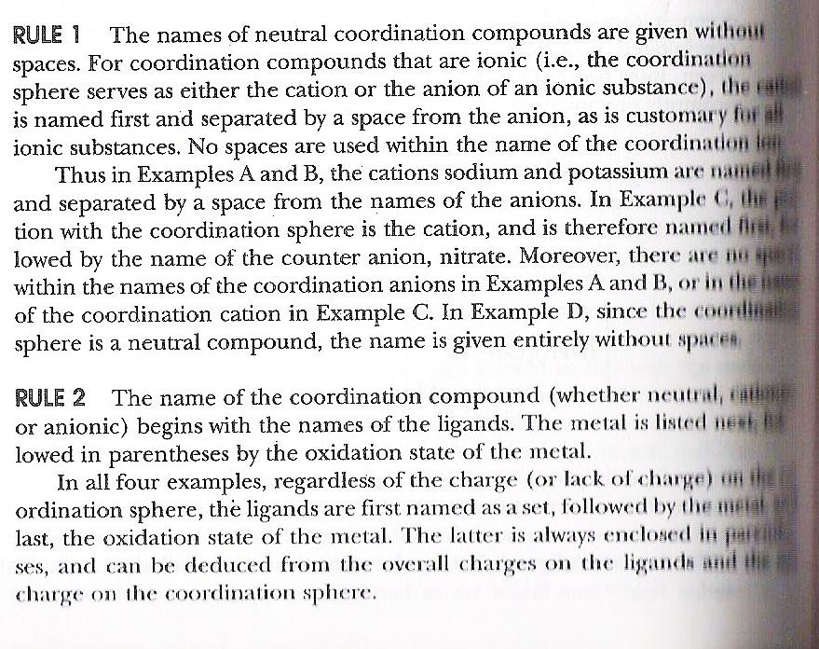
CHEM210/Chapter 3/2014/11

Slide 13
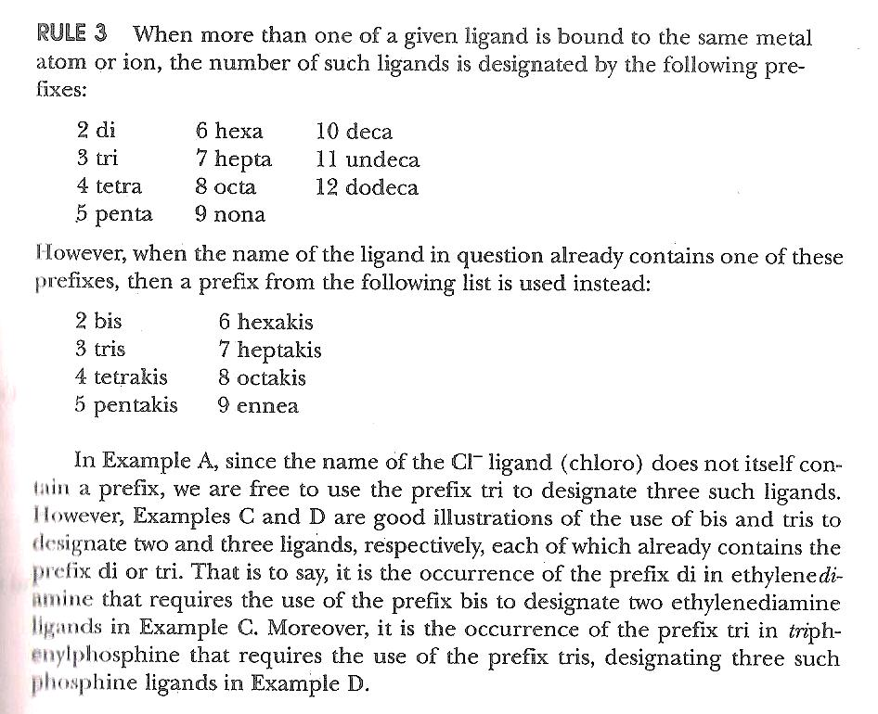
CHEM210/Chapter 3/2014/12

Slide 14
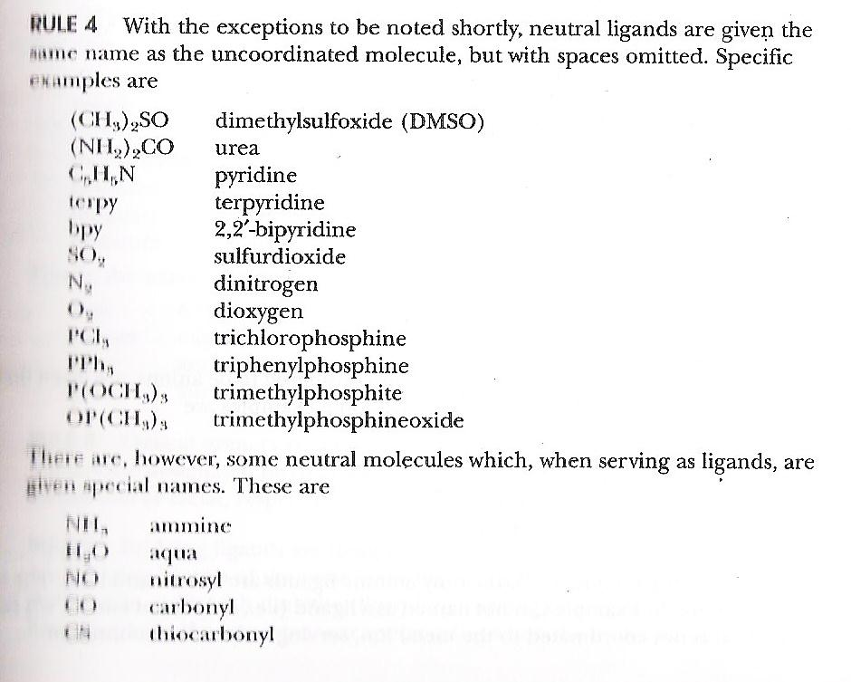
CHEM210/Chapter 3/2014/13

Slide 15
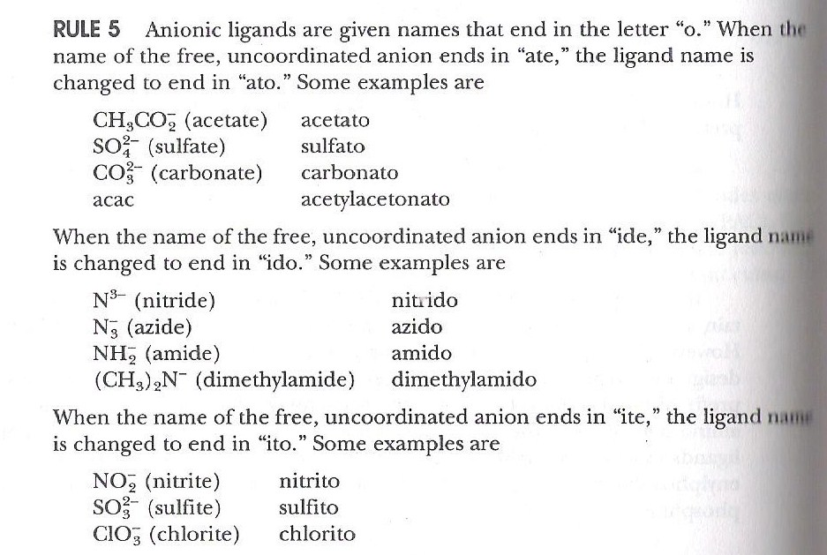
CHEM210/Chapter 3/2014/14

Slide 16
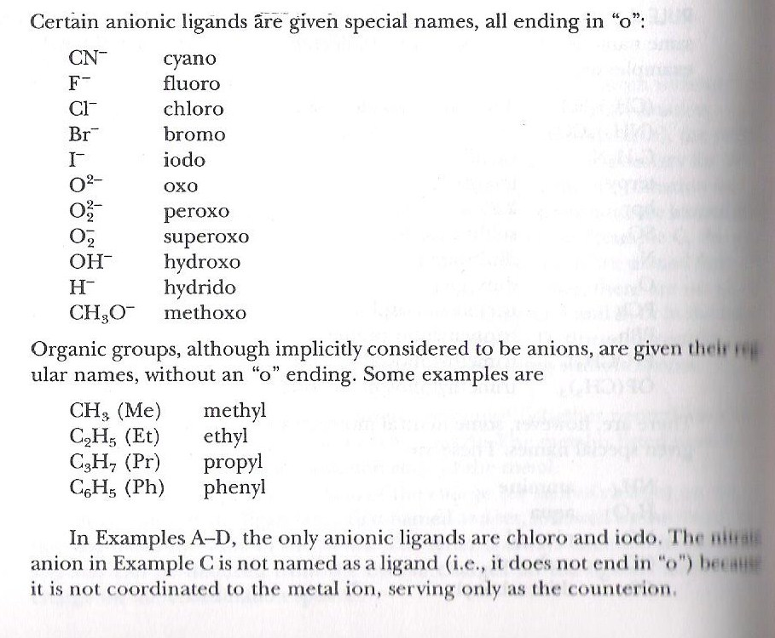
CHEM210/Chapter 3/2014/15

Slide 17
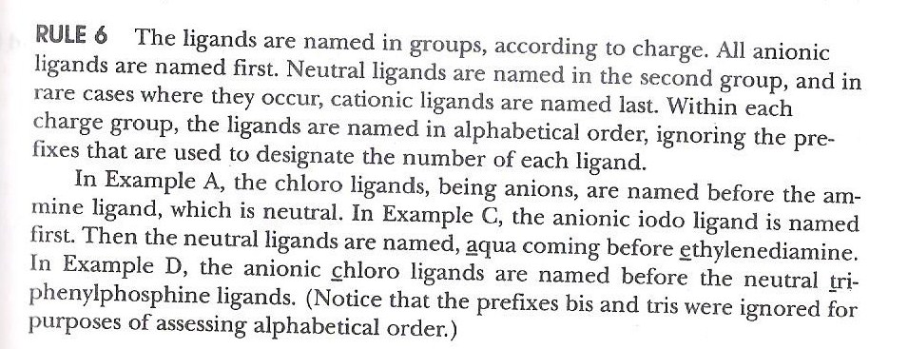
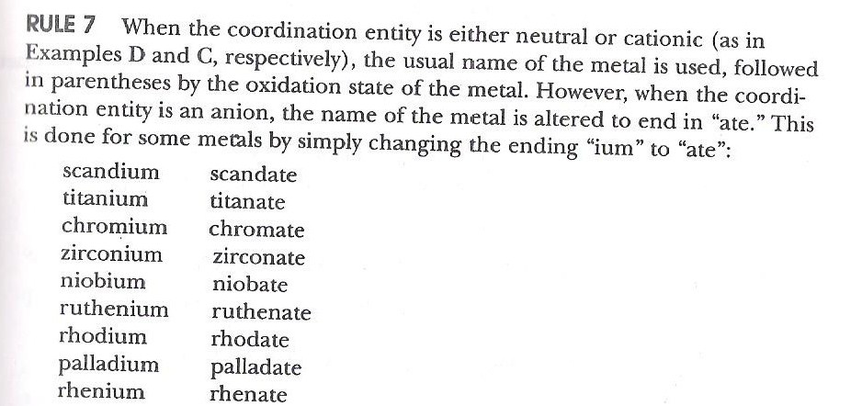
CHEM210/Chapter 3/2014/16

Slide 18
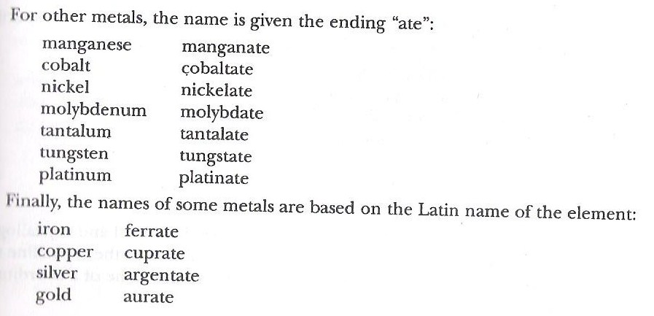
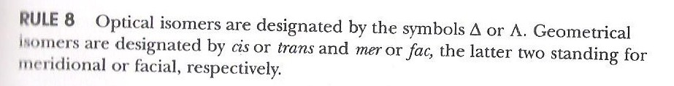
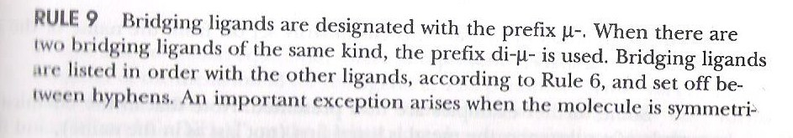
CHEM210/Chapter 3/2014/17

Slide 19
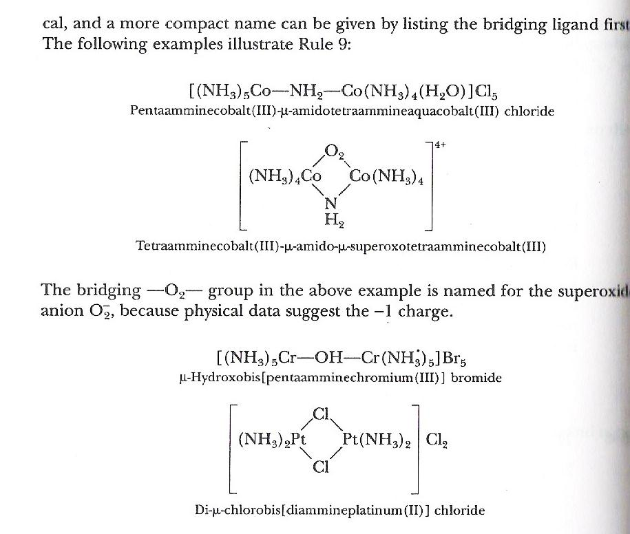
CHEM210/Chapter 3/2014/18

Slide 20
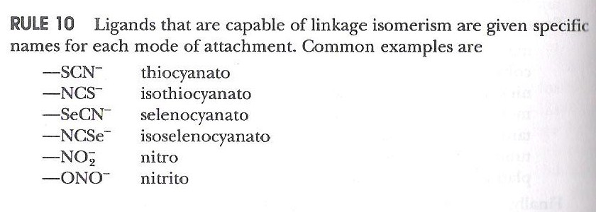
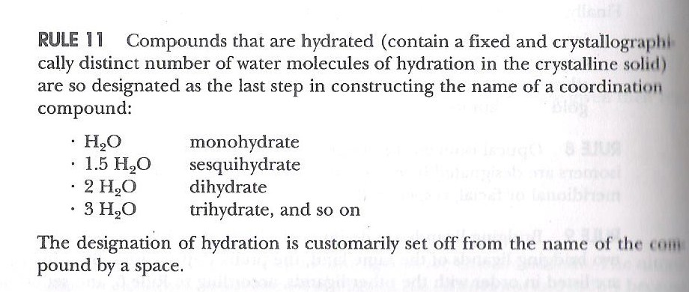
CHEM210/Chapter 3/2014/19

Slide 21
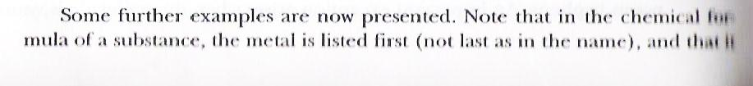
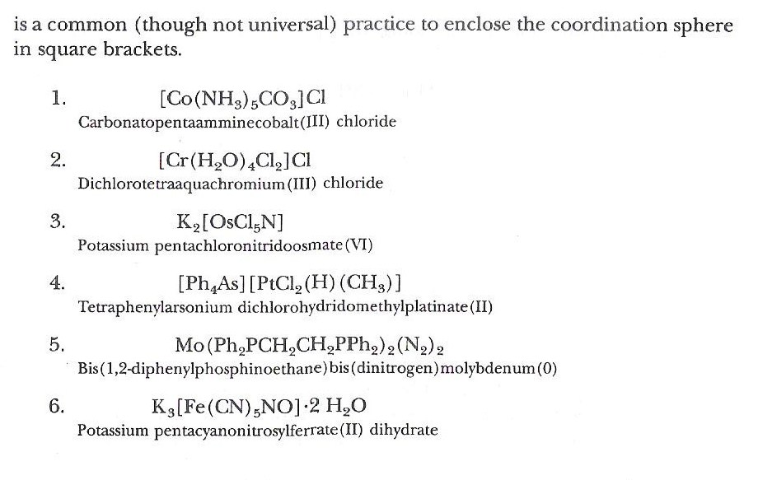
CHEM210/Chapter 3/2014/20

Slide 22
THANK YOU

